Slide 1


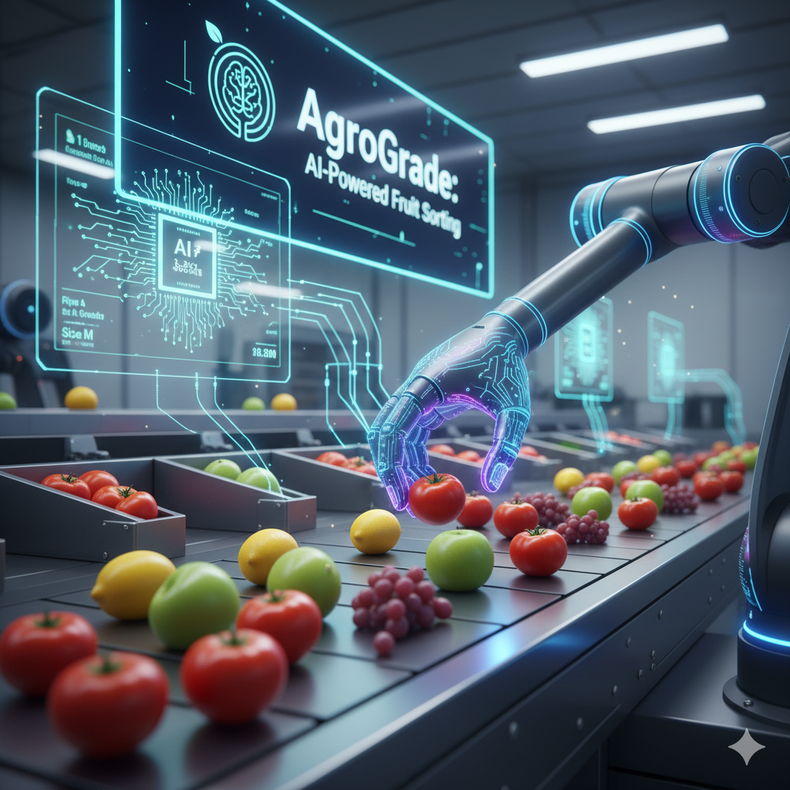
CHIP TO CROP 24 HOURS AGRITECH HACKATHON
Problem Statement Title - AgroGrade: AI-Powered Fruit Sorting
Team Name - TECH MAVERICKS
FAIZAN AHMED - 20221CSE0021
PAVAN K - 20221CSE0294
HARSHA VARDHANA T - 20221CSE0224
SAYAN DAS - 20221CSG0042
PRASHANTH A - 20221CDV0028
POONACHA TC - 20231ECE0090

Slide 2
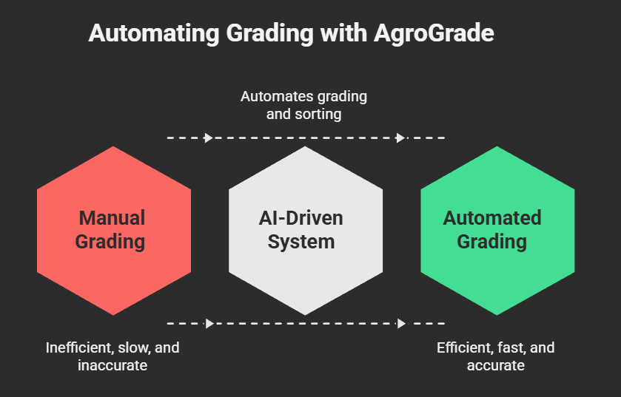
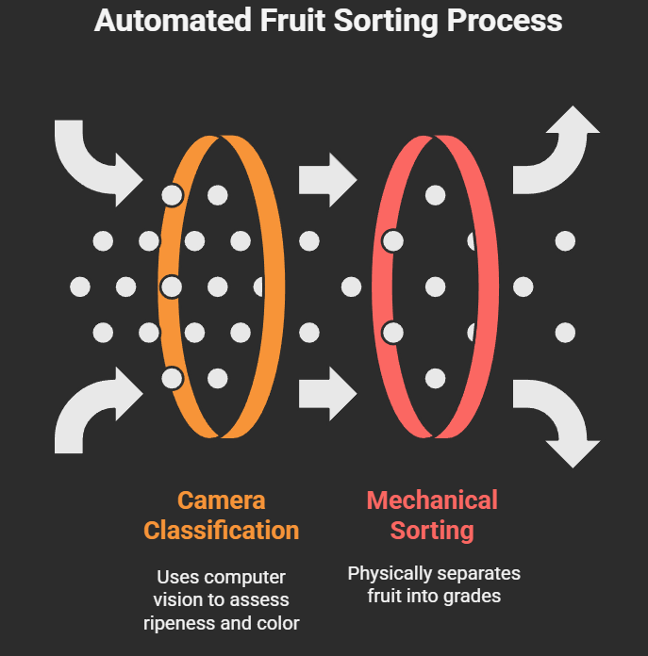
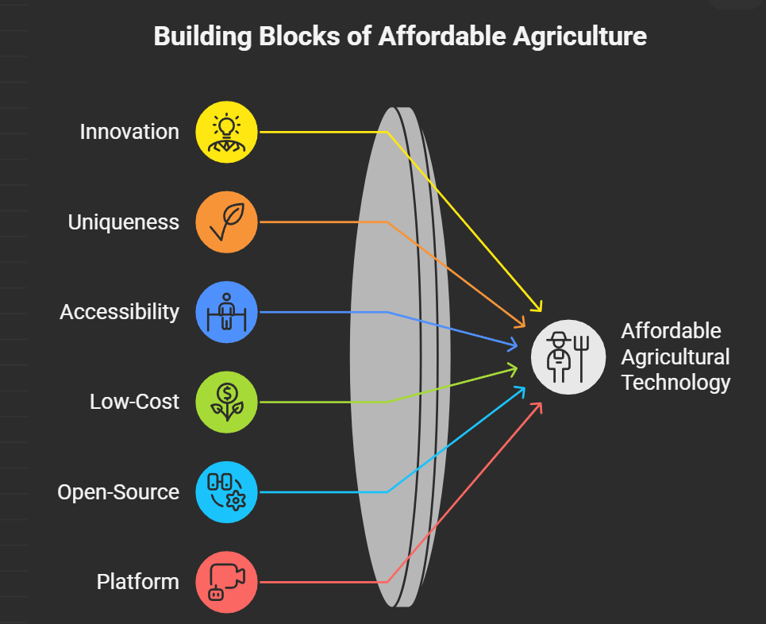
PROPOSED SOLUTION
Our Solution: Project AgroGrade
How it Addresses the Problem:
Innovation and Uniqueness:
AgroGrade is an AI-driven system that fully automates the grading and sorting process, designed specifically for small-scale farms.
It uses a camera with computer vision to instantly classify fruit based on its ripeness and color.
A software-controlled mechanical gate then physically sorts the fruit into different grades.
This process ensures uniform quality, significantly cuts down on sorting time, and removes the need for intensive manual labor.
Our system is built on an accessible, low-cost, open-source platform (Raspberry Pi and OpenCV) Making advanced agricultural technology affordable for all farmers.

Slide 3
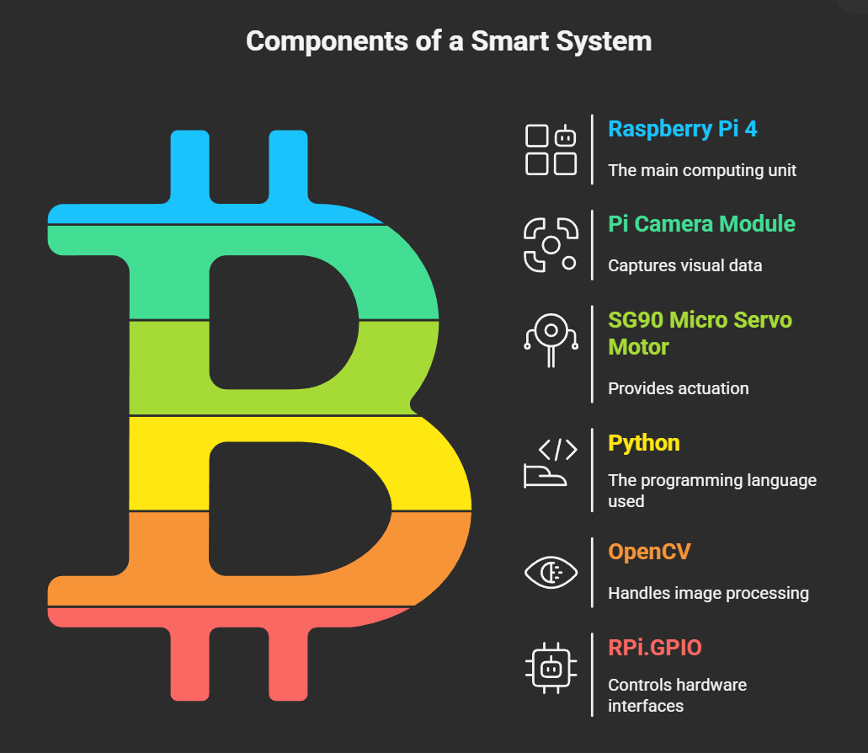
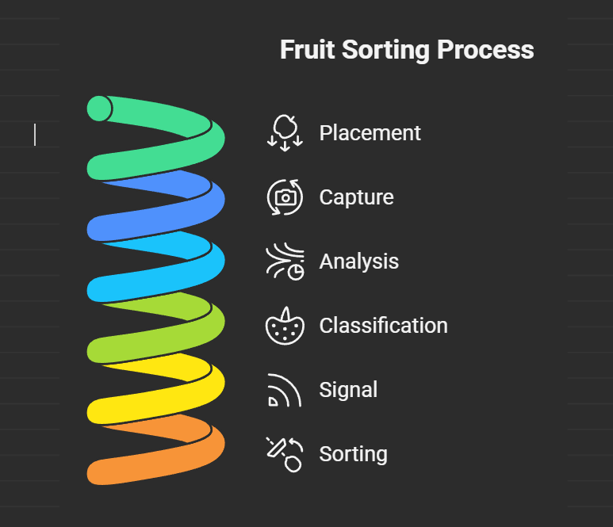
TECHNICAL APPROACH
Technologies Used:
Hardware: Raspberry Pi 4 (Compute), Pi Camera Module (Vision), SG90 Micro Servo Motor (Actuation).
Software: Python (Programming Language), OpenCV (Image Processing), RPi.GPIO (Hardware Control).
Implementation Methodology (Process Flow):
Placement: Fruit is placed on the inspection ramp.
Capture: The camera takes an image of the fruit.
Analysis: An OpenCV script analyzes the image for color thresholds.
Classification: The system classifies the fruit as "Ripe" or "Unripe".
Signal: The Raspberry Pi signals the servo motor.
Sorting: The servo gate directs the fruit into the correct bin.

Slide 4
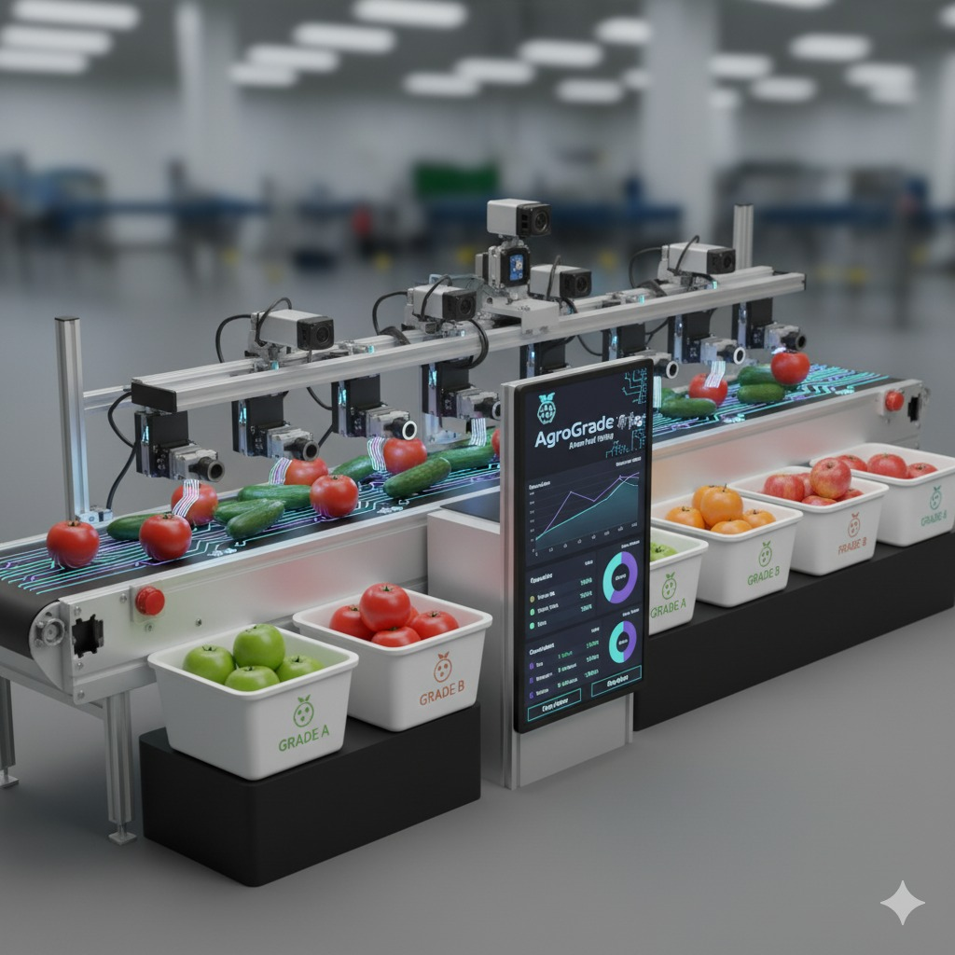
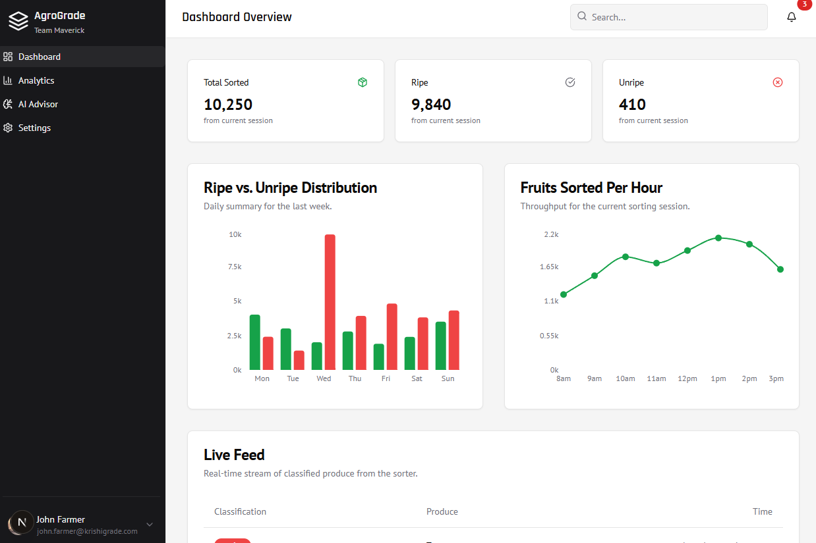
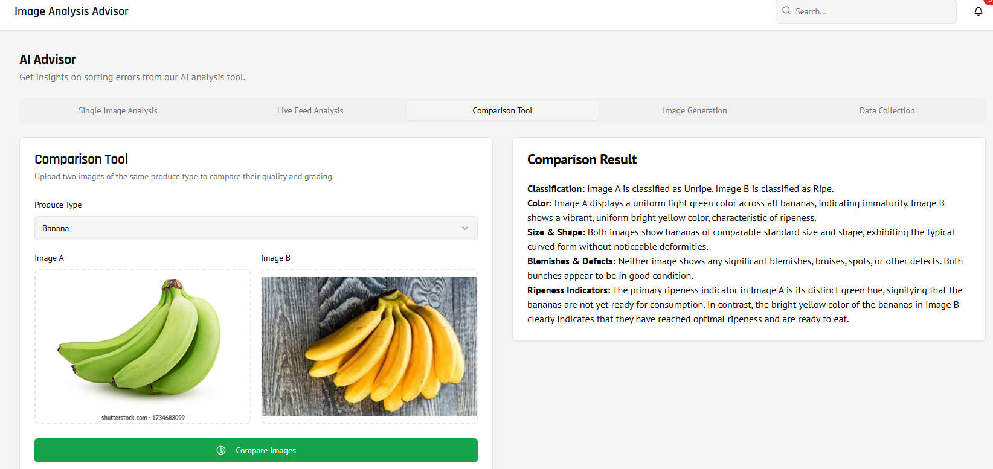
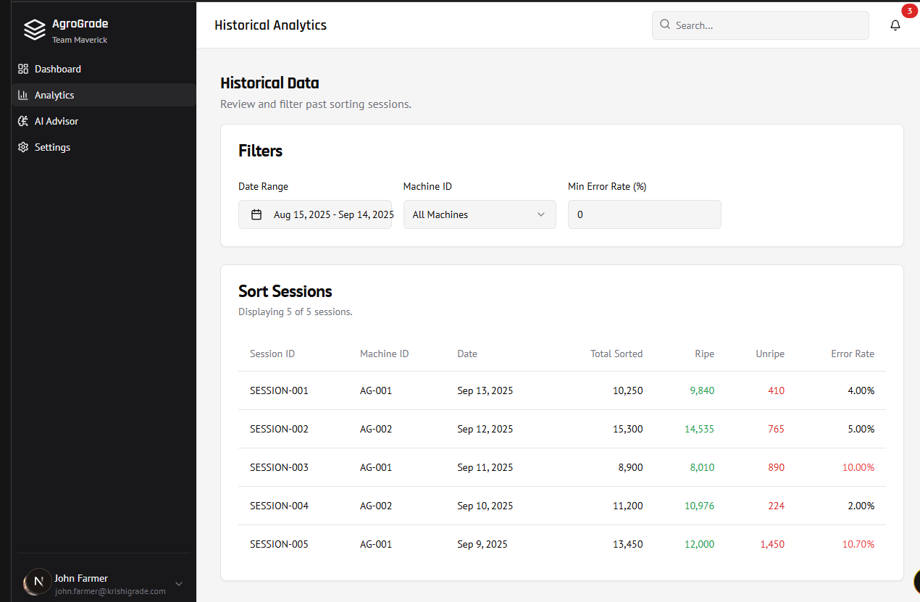
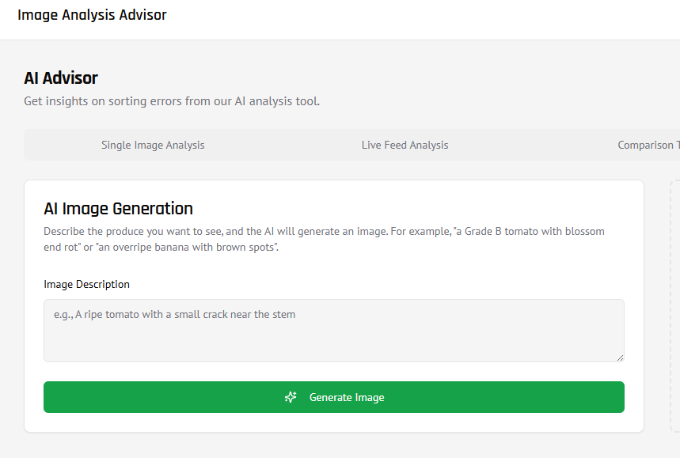
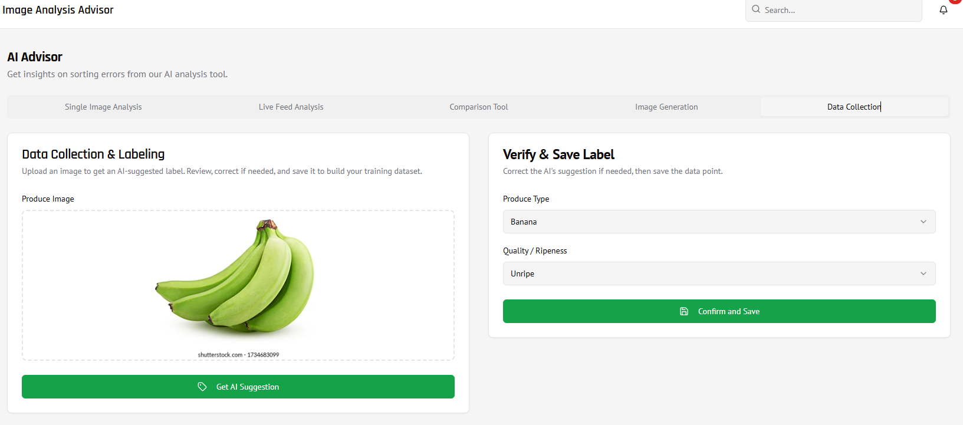
3D MODEL & PROTOTYPE

Slide 5
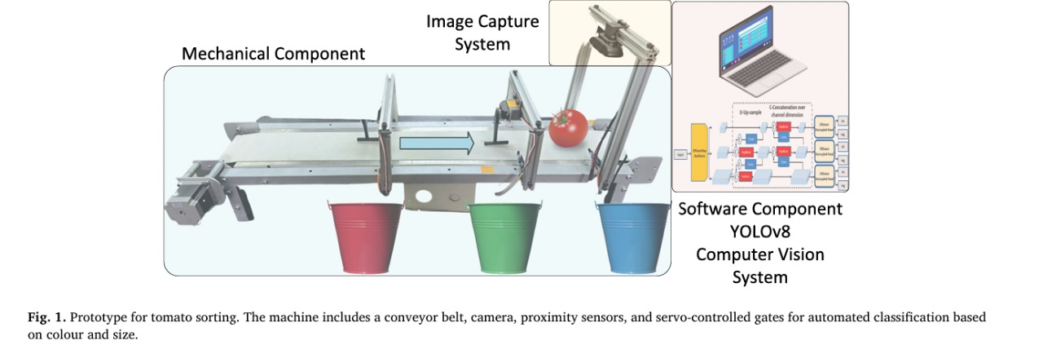
3D MODEL & PROTOTYPE

Slide 6
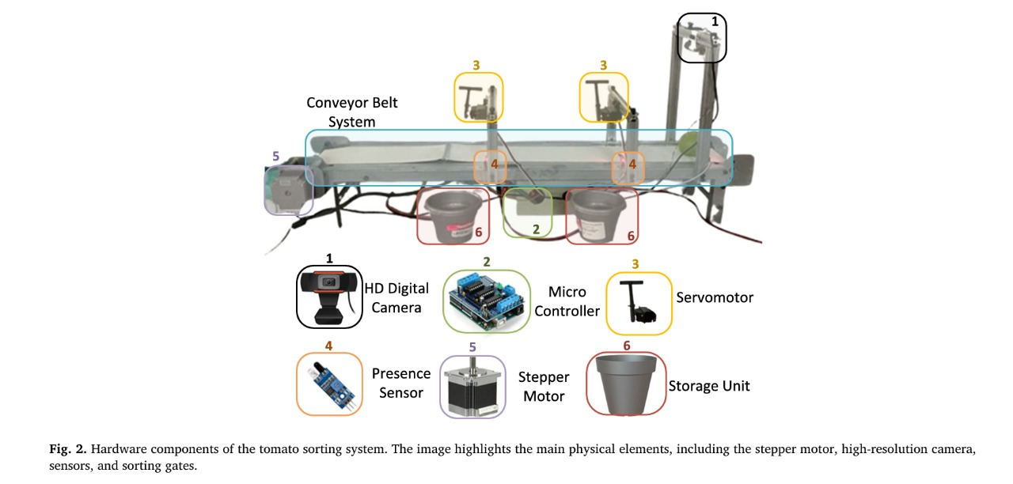
3D MODEL & PROTOTYPE

Slide 7
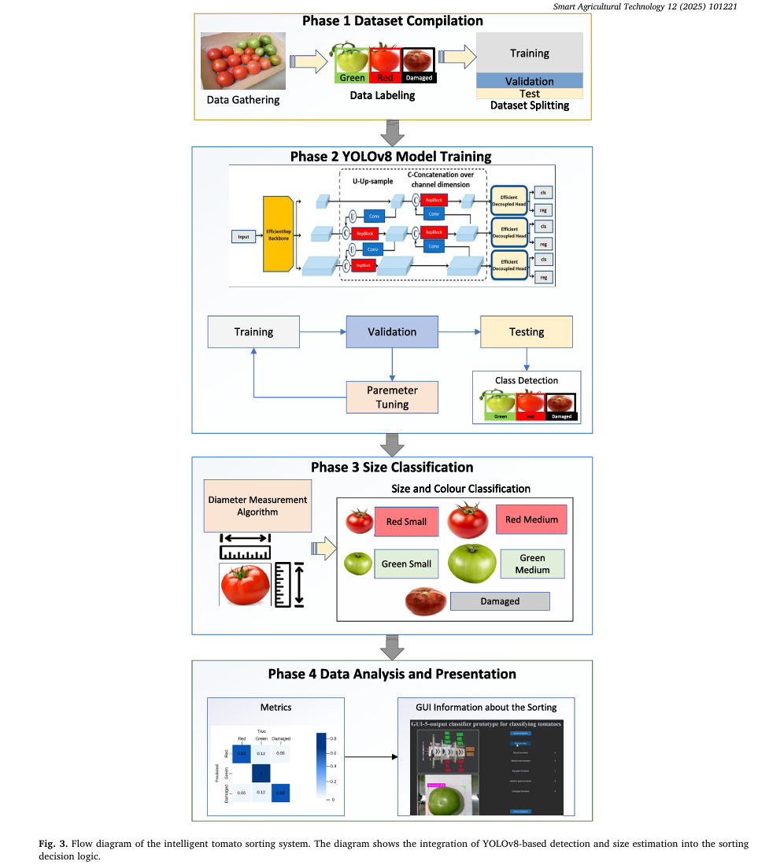
WORKFLOW

Slide 8
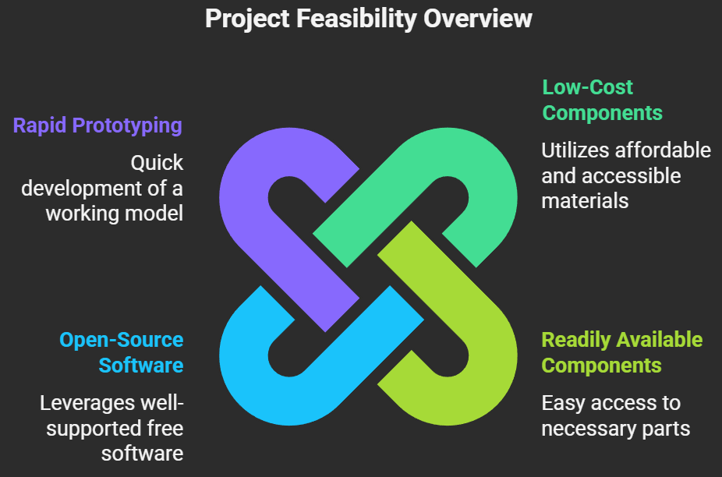
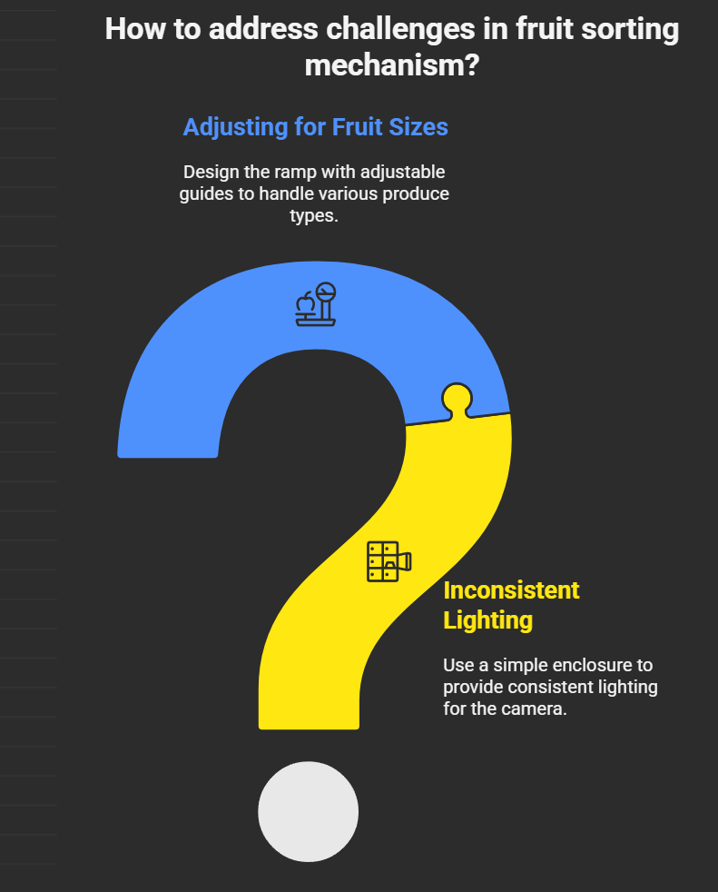
FEASIBILITY AND VIABILITY
Potential Challenges & Solutions:
Challenge: Inconsistent lighting affecting color accuracy.
Solution: Use a simple enclosure to provide consistent lighting for the camera.
Challenge: The mechanism may need adjustments for different fruit sizes.
Solution: Design the ramp with adjustable guides to handle various produce types.
Feasibility: The project is highly feasible because it uses low-cost, readily available components and well-supported open-source software. A working prototype can be built within 24 hours.

Slide 9
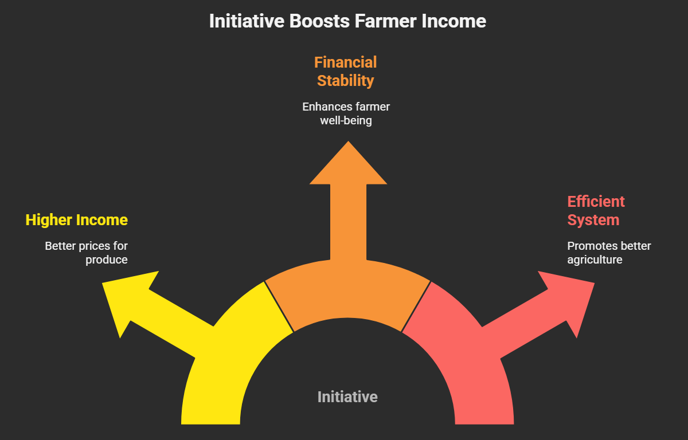
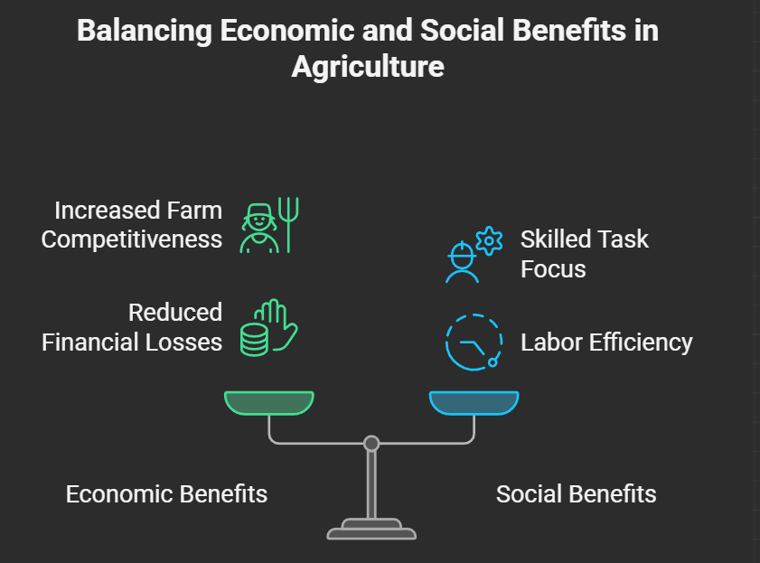
IMPACT AND BENEFITS
Benefits of the Solution:
Economic: Makes small farms more competitive and reduces post-harvest financial losses.
Social: Frees up farm workers from tedious manual labor, allowing them to focus on more skilled tasks.
Environmental: Reduces food waste by efficiently sorting produce for different market needs (e.g., immediate sale vs. transport).
Potential Impact:
Directly increases farmer income by reducing labor costs and ensuring better prices for consistently graded produce.

Slide 10

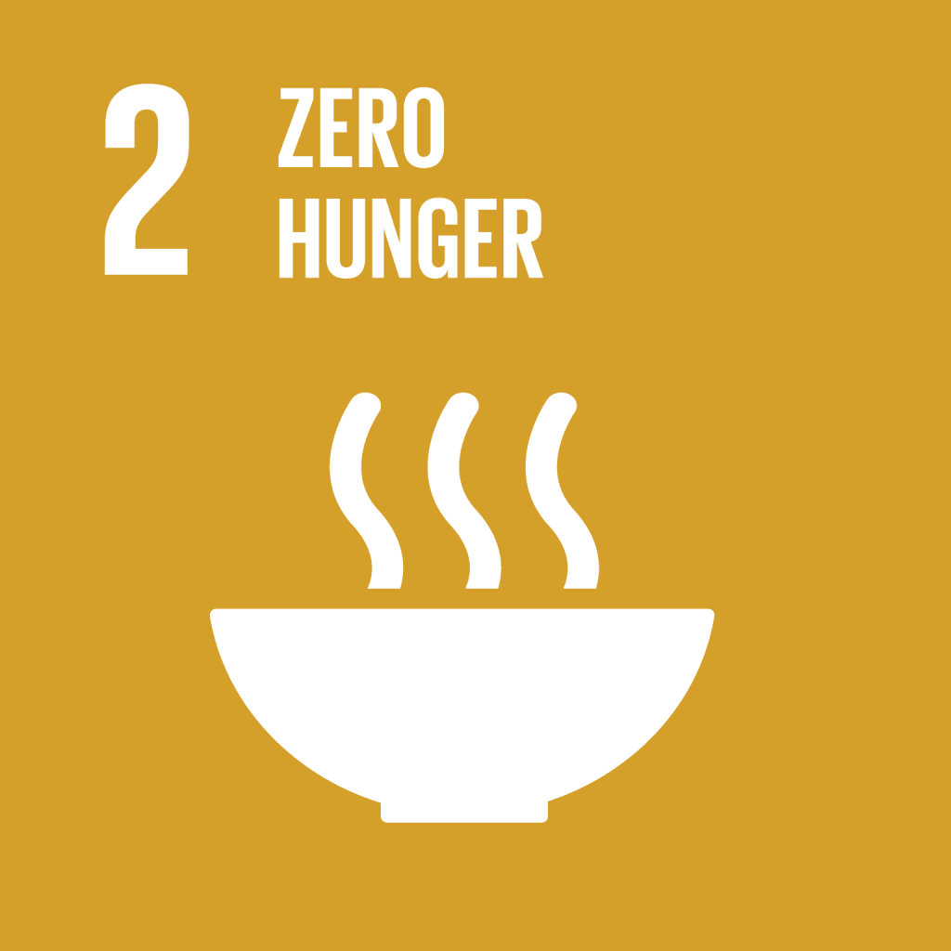



RESEARCH AND REFERENCES
Relevant Academic Papers
For a comprehensive overview of the field:
Paper: Bhargava, A., & Bansal, A. (2021). Fruits and vegetables quality evaluation using computer vision: A review. Journal of King Saud University - Computer and Information Sciences.
Relevance: This review paper provides a broad understanding of how computer vision is applied for quality evaluation in produce, validating the project's foundational approach.
For a specific implementation example:
Paper: Cubero, S., Aleixos, N., Albert, F., & Blasco, J. (2011). A new colour vision-based system for quality control of citrus fruits. Journal of Food Engineering.
Relevance: This paper details a practical system for sorting fruit based on color, which is a core feature of the AgroGrade project.
For low-cost system design:
Paper: Mohanty, A., Singh, V., & Kumar, D. (2020). Design and development of a low-cost automated system for fruit grading and sorting using image processing. International Journal of Engineering and Advanced Technology.
Relevance: This research focuses on creating an affordable sorting system, aligning directly with AgroGrade's goal of making technology accessible to small-scale farmers.
SDG 1: No Poverty
SDG 2: Zero Hunger
SDG 8: Decent Work and Economic Growth
SDG 9: Industry, Innovation, and Infrastructure
SDG 12: Responsible Consumption and Production

